Slide 1
Top down parsing

Slide 2
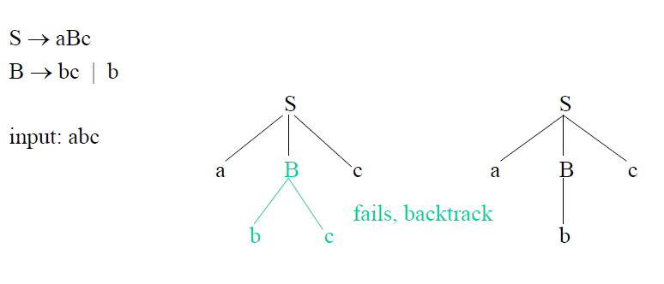
Back tracking in top down parsing

Slide 3
Predictive parser
It is a type of top down parser
It avoids backtracking
It is used to predict the next production to be selected among set of productions in the parsing process
LL(1) is a predictive parser
i.e. left to right scanning, left most derivation is used for the parsing, look ahead symbol is 1 in the parsing process

Slide 4
Predictive parser
If a parser to be predictive i.e. LL(1),
The grammar should not contain left recursion
A parsing table is required

Slide 5

Left recursion
A production of a grammar is said to have left recursion, if the left most variable of its RHS is same as variable of its LHS.
A grammar containing productions with left recursion is called left recursive grammar
If a production is left recursive, if the production is in the following form

Slide 6

Elimination of left recursion
We can eliminate the left recursion by replacing the production
by the following productions

Slide 7
Sample-1
A→ABd/Aa/a
B→Be/b
Two productions contains left recursion
Solution
A→aA’
A’→BdA’/ aA’/ϵ
B→bB’
B’→eB’/ ϵ

Slide 8
Sample-2
S→(L)/a
L→L,S/S
Solution
S→(L)/a
L→SL’
L’→,SL’/ ϵ

Slide 9
Another requirement for predictive parsing
First and follow sets from the grammar is required for the predictive parsing
First-set in a grammar is can be computed by the following algorithm

Slide 10
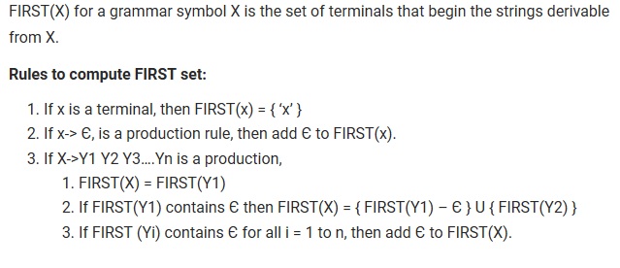
Compute First set

Slide 11
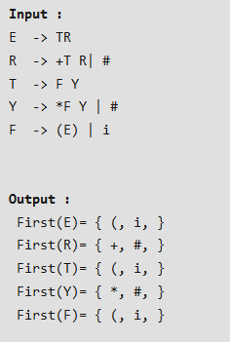
Example to compute first set

Slide 12
Example to compute first set
S→ABCDE
A→a/ϵ
B→b/ ϵ
C→c
D→d/ ϵ
E→e/ ϵ
First set:
First( S)→{ a,b,c }
First(A)→{a/ ϵ}
First(B)→{b/ ϵ}
First(C)→{c}
First(D)→{d, ϵ}
First(E)→{e, ϵ}

Slide 13
Compute follow
1) Place a $ in Follow(S), where S is the start symbol, and $ is the input right end marker
2) If there is a production
Then everything in
Except null production is in Follow(B)
3) If there is a production
Then everything in Follow(A) is in Follow(B)

Slide 14
Example to compute follow set
S→ABCDE
A→a/ϵ
B→b/ ϵ
C→c
D→d/ ϵ
E→e/ ϵ
First set:
First( S)→{ a,b,c } and Follow(S)→{ $}
First(A)→{a/ ϵ} and Follow(A)→{ b, c}
First(B)→{b/ ϵ} and Follow (B)→{ c }
First(C)→{c} and Follow (C) →{ d, e ,$ }
First(D)→{d, ϵ} and Follow (D)→{ e, $}
First(E)→{e, ϵ} and Follow(E) →{$}

Slide 15
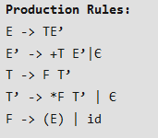
Compute follow

Slide 16
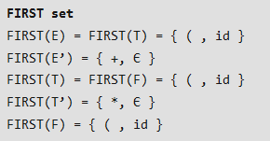
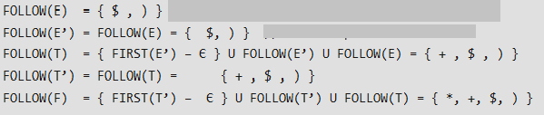
Follow
kjdfkdfksksdkfds

Slide 17
LL(1) grammar
Predictive parsers are deterministic parsers that does not require back tracking
LL(1) is a class of predictive parser
First L stands for left to right scanning, second L for producing left most derivation and 1 for using one input symbol of lookahead symbol at each step to make parsing action decisions

Slide 18
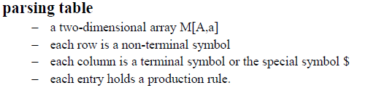
LL(1) parsing table

Slide 19
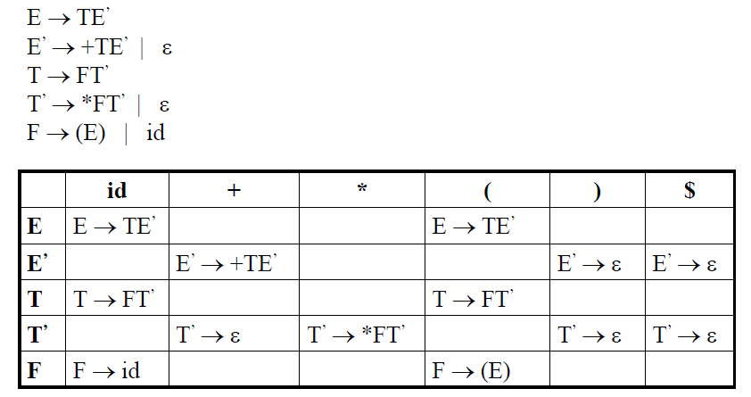
Parsing table for the following grammar

Slide 20
How to check whether the grammar is LL(1) or not
If the parsing table contains only single entry in each column, then the grammar is considered as LL(1).
If any column in the parsing table contains multiple entries, the given grammar is not considered as LL(1)

Slide 21

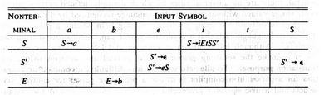
A non LL(1) grammar

